Slide 1
C# & .NET Framework
Chapter 1: The Philosophy of .NET
Chapter 2: Building C# Applications

Slide 2
Chapter 1: Objectives
The limitations of the previous Technologies/Programming Languages
The .NET Solution
.NET base class libraries
An Overview of .NET Assemblies
Assembly Metadata and Manifest

Slide 3
Chapter 1: Objectives
Common Intermediate Language (CIL)
Common Type System (CTS)
Common Language Specification (CLS)
Common Language Runtime (CLR)
The Assembly/Namespace/Type Distinction
Using ildasm.exe
Deploying the .NET Runtime

Slide 4
Previous State of Affairs
Life As a C/Win32 API Programmer
Manual memory management, ugly pointer arithmetic, and ugly syntactical constructs
Life As a C++/MFC Programmer
Difficult to learn and error-prone experience
Life As a Visual Basic 6.0 Programmer
not a fully object-oriented, no multithread supports (unless working with low level of Win32 API calls)
Life As a Java/J2EE Programmer
No language integration, not appropriate for many graphically or numerically intensive applications
Life As a COM Programmer
no support for classical inheritance, very complex to build and use

Slide 5
The .NET Solution
Full interoperability with existing code
Complete and total language integration
A common runtime engine shared by all .NET-aware languages.
A base class library
No more COM plumbing
A truly simplified deployment model (no need to register a binary unit into the system registry)

Slide 6
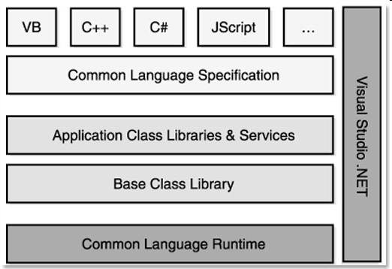
The .NET Solution
.NET Framework Overview

Slide 7
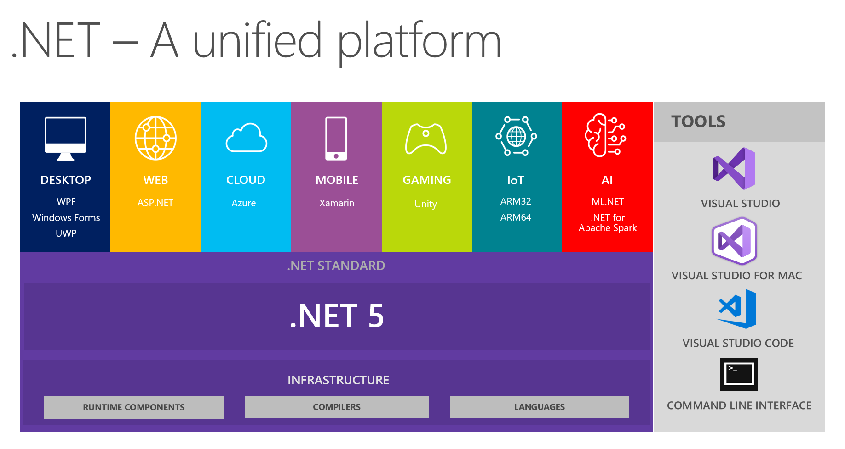
The .NET Solution
.NET 5 Overview

Slide 8
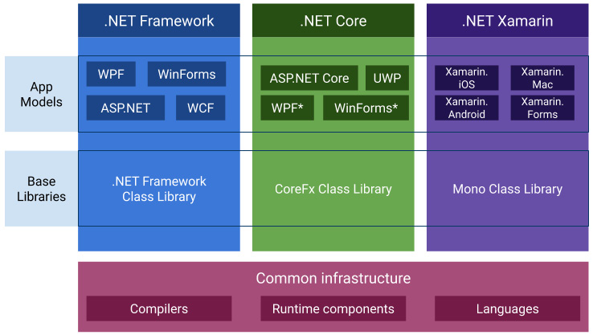
The .NET Solution
.NET Overview

Slide 9
.NET Platform Components
Base class library.
Common Language Runtime (CLR).
Common Type System (CTS).
Common Language Specification (CLS).

Slide 10
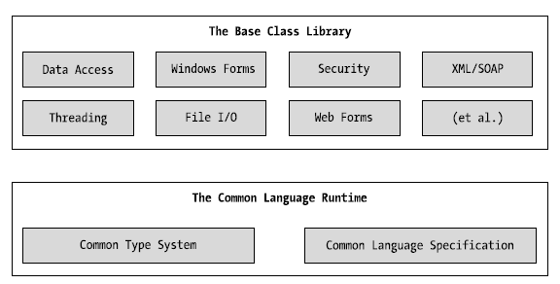
.NET Platform Components
The CLR, CTS, CLS, and base class library relationship

Slide 11
Base Class Libraries
Defines classes available to all .NET Framework languages
Defines various primitives:
threads, file input/output, graphical rendering, interaction with external hardware devices
database access, XML manipulation, security

Slide 12
Additional .NET-Aware Programming Languages
Examples:
C#
Managed Extensions for C++
Java - Visual J# .NET
JavaScript - JScript .NET
Perl
Pascal, Delphi
PHP
Smalltalk

Slide 13
Common Language Runtime (CLR)
CLR is physically represented by mscoree.dll library (Common Object Runtime Execution Engine)
this library is loaded automatically when an assembly is referenced for use
CLR responsibilities:
resolving the location of an assembly and finding the requested type within the binary by reading the contained metadata
loading the type into memory
compiling CIL into platform-specific instruction
performing security checks, executing the code

Slide 14
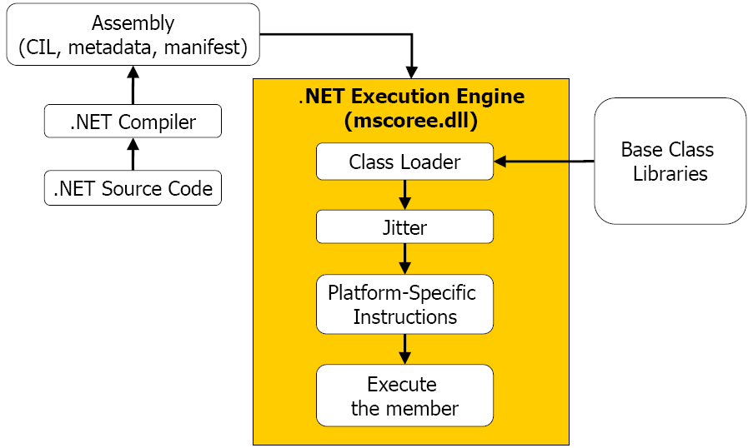
Common Language Runtime (CLR)
mscoree.dll in action

Slide 15
Common Type System (CTS)
CTS fully describes all possible data types and programming constructs (types) supported by the runtime and details how they are represented in the .NET metadata format
Types in .NET:
Classes (sealed classes, implementing interfaces, abstract Classes, internal or public classes)
structures
Interfaces (named collections of abstract member definitions)
Enumerations
Delegates (equivalent of type-safe function pointer)

Slide 16
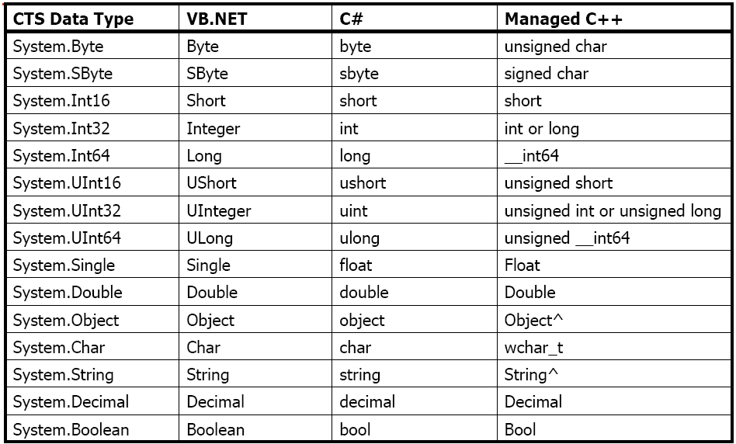
Intrinsic CTS Data Types

Slide 17
Common Language Specification (CLS)
CLS defines a subset of common types and programming constructs that all .NET programming languages can agree on in order to interoperate successfully.
CLS can be viewed as a subset of the full functionality defined by the CTS.
Also, CLS defines a set of rules/features a given .NET-aware compiler must support to produce code that can be hosted by the CLR
Ex: overloading: methods, and constructors are allowed to be overloaded; fields and events must not be overloaded
(Refer to Chapter 3, Table 3-11, Page 118)

Slide 18
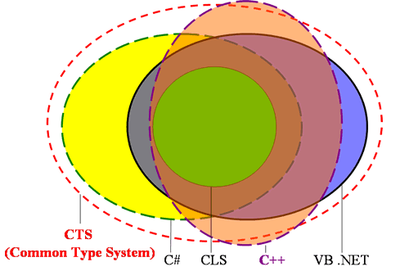
CTS and CLS

Slide 19
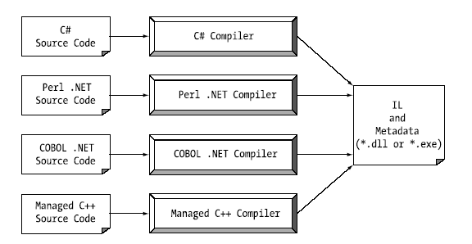
.NET Assemblies Overview
Assembly

Slide 20
.NET Assemblies Overview
.NET Assemblies:
Binaries containing Common Intermediate Language (CIL)
instructions and type metadata
dll or .exe files, which cannot be run without the .NET runtime
The most important features:
versioning
self-describing
configurable (using private/global assembly via App.config)

Slide 21
.NET Assemblies Overview
.NET Assembly's Format:
Win32 File Header
CLR File Header
CIL code
metadata
assembly manifest
optional embedded resource

Slide 22
Single-File and Multi-file Assemblies
Single-file assembly: a simple one-to-one correspondence between a .NET assembly and the binary file (.dll or .exe)
Multi-file assemblies: composed of numerous .NET binaries (modules):
One of these modules (primary module) must contain the assembly manifest
Multi-file assemblies allow to use more flexible deployment option (e.g. the user is forced to download only selected modules)

Slide 23
Common Intermediate Language (CIL)
Also known as Microsoft Intermediate Language (MSIL)
CIL is a language that sits above any particular platform- specific instruction set
the same idea as Java's virtual machine
Compilers of all .NET-aware languages emit CIL instructions
binaries are platform-independent
When the CIL code is about to run, the Jitter (just-in-time compiler) compiles it into native (machine) code
Jitter will cache resulting machine code in memory

Slide 24
Assembly/Namespace/Type Distinction
Namespace is a grouping of related types contained in an assembly
A single assembly can contain any number of namespaces

Slide 25
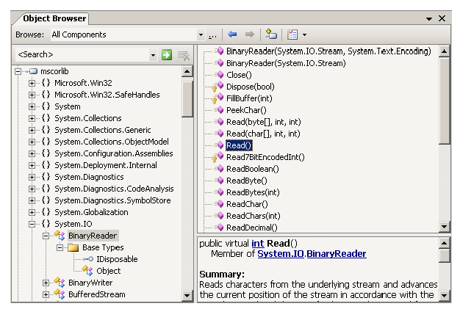
Assembly/Namespace/Type Distinction
Namespace: System.IO
Type: BinaryReader
Assembly: System.IO.dll (stored in hard disk)

Slide 26
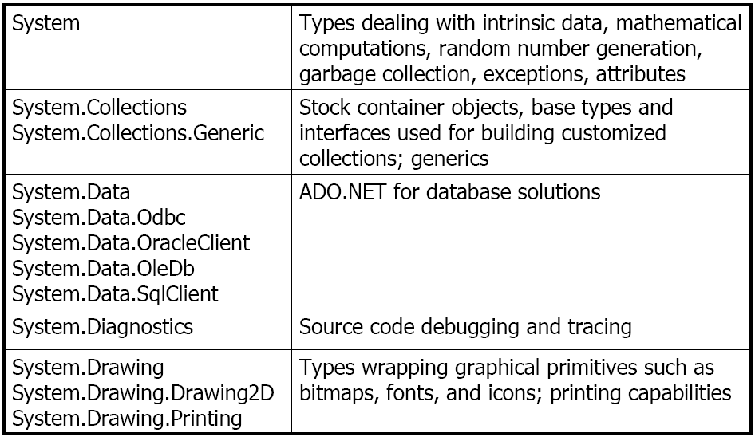
Assembly/Namespace/Type Distinction
Standard .NET Namespaces

Slide 27
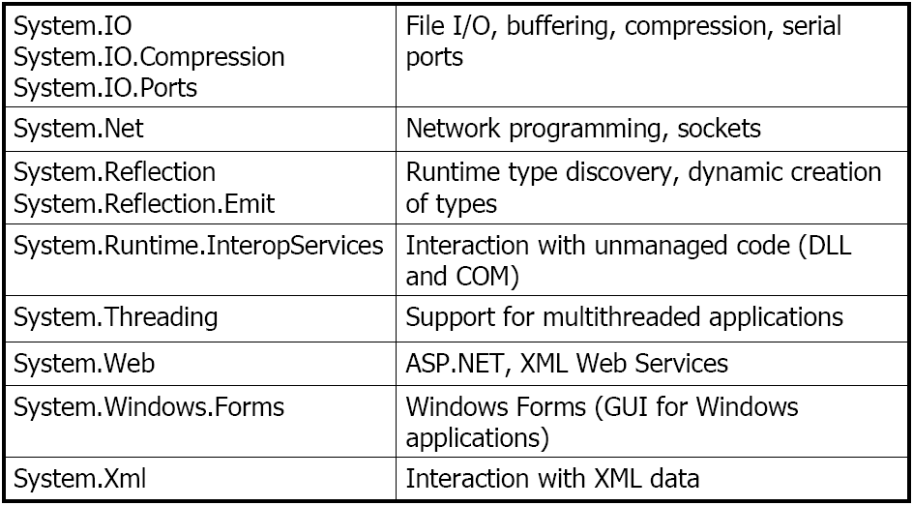
Assembly/Namespace/Type Distinction
Standard .NET Namespaces

Slide 28
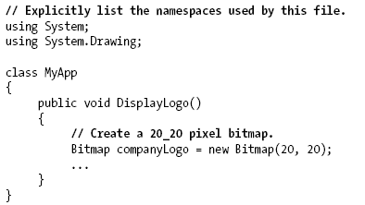
Assembly/Namespace/Type Distinction
Using a Namespace:

Slide 29
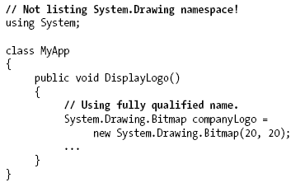
Assembly/Namespace/Type Distinction
Not using Namespace:

Slide 30
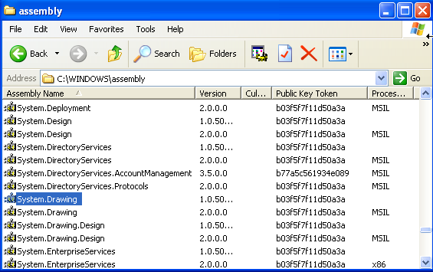
Assembly/Namespace/Type Distinction
Referencing External Assemblies

Slide 31
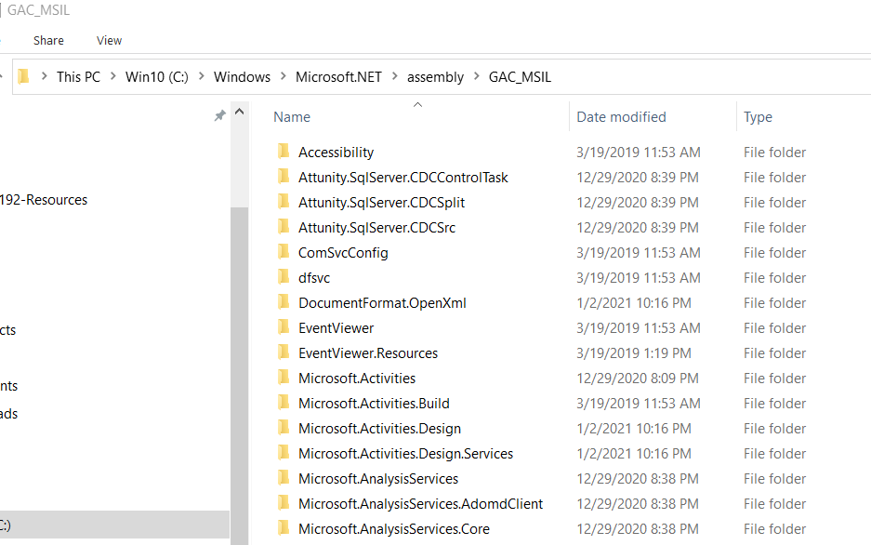
Assembly/Namespace/Type Distinction
Referencing External Assemblies

Slide 32
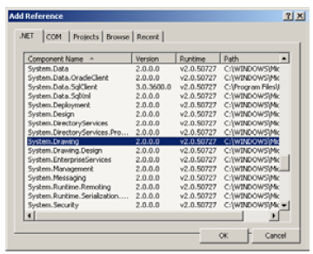
Assembly/Namespace/Type Distinction
To use types from external assembly, we need to add that assembly to our project
We will learn how to add an assembly to our project in next chapters

Slide 33
Using ildasm.exe
Located at:
Used to view an assembly’s content: CIL code, manifest, metadata.
Other Tool:
Lutz Roeder's .NET Reflector (http://www.aisto.com/roeder/dotnet/) shows CIL code and its representation in C#, VB.NET, C++, Delphi, and other languages
C:\Program Files\Microsoft Visual Studio 8\SDK\v2.0\Bin\ildasm.exe

Slide 34
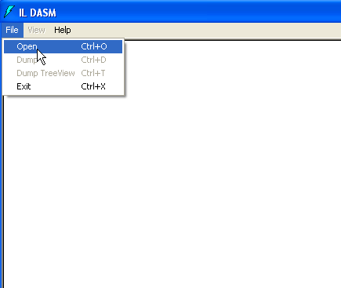
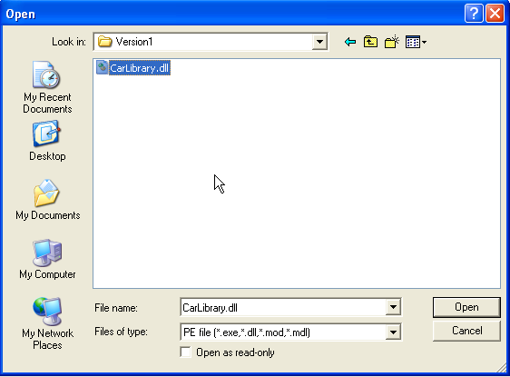
Using ildasm.exe
This file is just an example. You can use any .NET dll or exe file to view its content

Slide 35
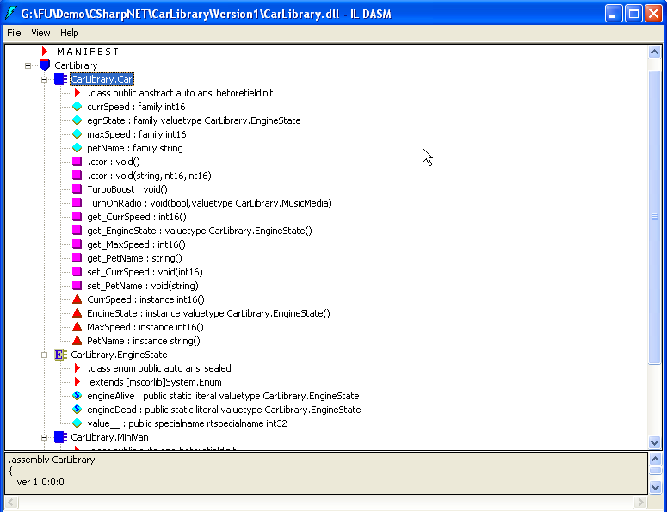
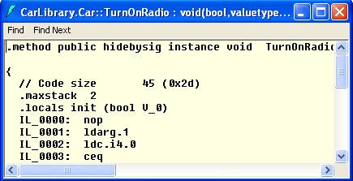
Using ildasm.exe
CIL code
Double click one item to view CIL code

Slide 36
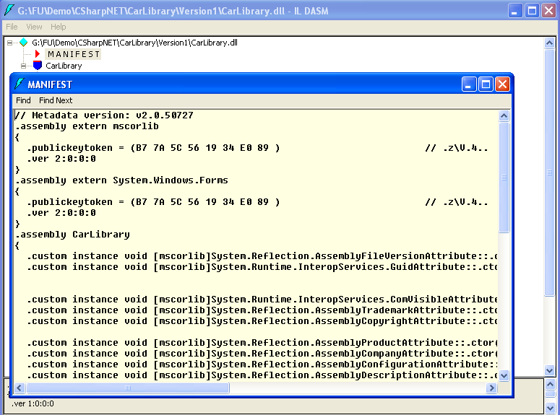
Using ildasm.exe
Double click on “MANIFEST” to view manifest info
Manifest info

Slide 37
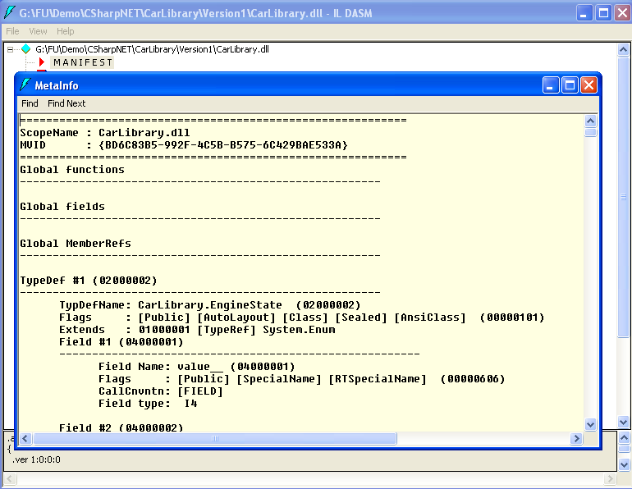
Using ildasm.exe
Press Ctrl + M to view metadata info
Metadata info

Slide 38
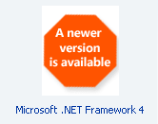
Deploying the .NET Runtime
.NET assemblies can be executed only on a machine that has the .NET Framework installed.
.NET Framework 1.1 was included in Windows Server 2003 and was an optional component of Windows XP Service Pack 1.
Redistributable packages (dotnetfx.exe)
.NET Framework 1.1
23.1 MB
Windows 98/Me/NT/2000/XP/2003, IE 5.01
.NET Framework 2.0
22.4 MB
Windows 98/Me/NT/2000/XP SP2/2003, IE 5.01
Windows Installer 3.0
disk space: 280 MB (x86), 610 MB (x64)

Slide 39
The Platform-Independent Nature of .NET
Mono project (http://www.mono-project.com)
support for .NET client and server applications on Linux, Solaris, Mac OS X, Windows and Unix
sponsored by Novell
LGPL (Lesser General Public Licence)
Portable .NET (http://www.dotgnu.org)
supported systems: GNU/Linux, NetBSD, FreeBSD, Cygwin/Mingw32, Mac OS X, Solaris, AIX
GPL (General Public Licence)
Official international standards:
ECMA-334: The C# Language Specification
ECMA-335: The Common Language Infrastructure (CLI)

Slide 40
Chapter 1: Summary
.NET base class libraries
.NET Assemblies
Assembly Metadata and Manifest
Common Intermediate Language (CIL)
Common Type System (CTS)
Common Language Specification (CLS)
Common Language Runtime (CLR)

Slide 41
Q & A
1.C#_Ngày_1_Lab_01
2.C#_Ngày_1_Lab_02

Slide 42
C# & .NET Framework
Chapter 2: Building C# Applications

Slide 43
Chapter 2: Objectives
Configuring C# Command-Line Compiler
Building C# Applications Using csc.exe
Building .NET Applications Using Visual Studio 2005

Slide 44
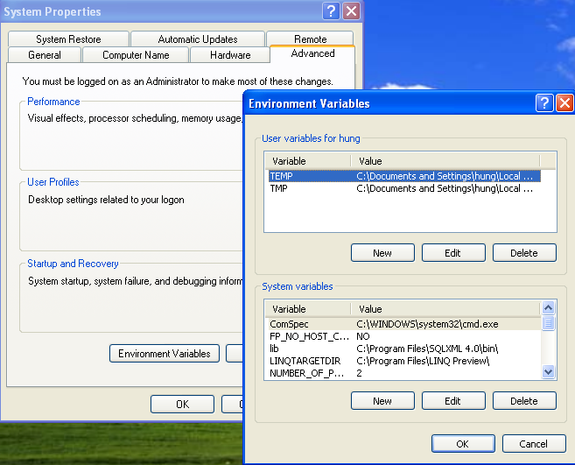
Configuring C# Command-Line Compiler
Right-click the My Computer icon and select Properties from the pop-up menu
Select the Advanced tab and click the Environment Variables button

Slide 45
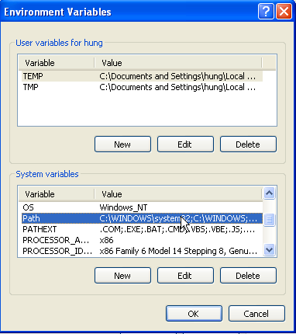
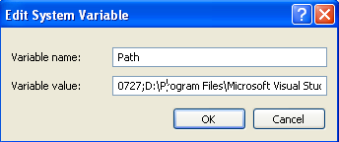
Configuring C# Command-Line Compiler
Double-click the Path variable from the System Variables list box
Add the following line to the end of the current Path value (note each value in the Path variable is separated by a semicolon):
Add to the end, separated by a semicolon (;)
C:\Windows\Microsoft.NET\Framework\v2.0.50215
Note that your .NET path on your computer may be different

Slide 46
Configuring C# Command-Line Compiler
Configuring Additional .NET Command-Line Tools
Add the path of your .NET Visual Studio to the Path variable like the previous step
For example:
C:\Program Files\Microsoft Visual Studio 8\SDK\v2.0\Bin
Add to the end, and do not forget to separate with a semicolon (;)

Slide 47
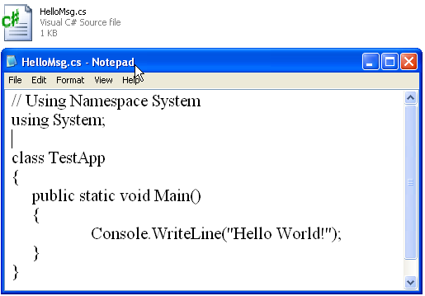
Building C# Applications Using csc.exe
Open Notepad and enter the content as below. Save file with the extension .cs.
File name and class name does not need to be the same

Slide 48
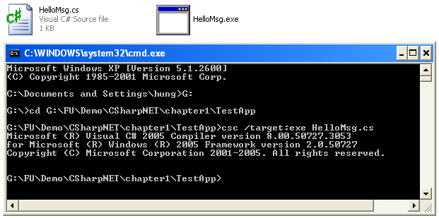
Building C# Applications Using csc.exe
Compile the cs file
csc /target:exe HelloMsg.cs [/out “file name”]
Or:
csc /t:exe HelloMsg.cs [/out “file name”]

Slide 49
Building C# Applications Using csc.exe
Other compiling options
Option | Description
/out | This option is used to specify the name of the assembly to be created.
/target:exe | This option builds an executable console application. This is the default file output type
/target:library | This option builds a single-file *.dll assembly.
/target:module | This option builds amodule.Modules are elements of multifile assemblies (fully described in Chapter 11).
/target:winexe | Although you are free to build Windows-based applications using the /target:exe flag, the /target:winexe flag prevents a console window from appearing in the background.

Slide 50
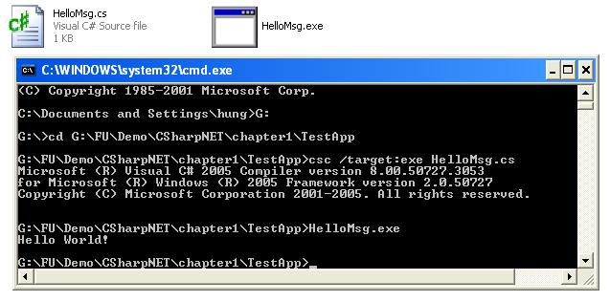
Building C# Applications Using csc.exe
Execute the program

Slide 51
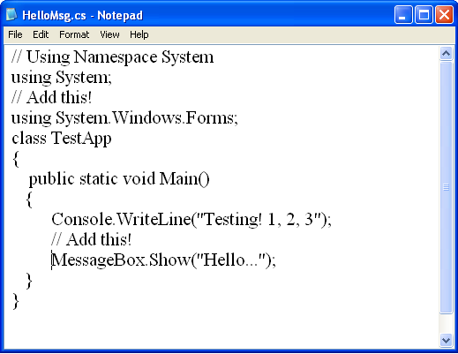
Building C# Applications Using csc.exe
Using reference option
Add these two lines

Slide 52
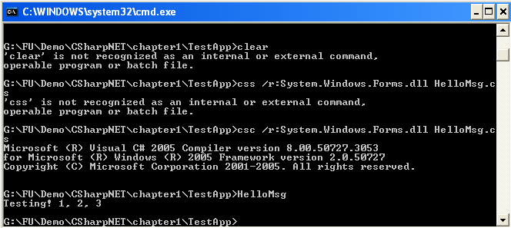

Building C# Applications Using csc.exe
Compiling with reference option
csc /r:System.Windows.Forms.dll HelloMsg.cs

Slide 53
Building C# Applications Using csc.exe
Compiling with multi cs file
In case there are many cs file in a folder, use *.cs to compile all the cs source file.
csc /target:exe *.cs

Slide 54
Building C# Applications Using csc.exe
Working with Response Files
C# response files contain all the instructions to be used during the compilation of your current build.

Slide 55
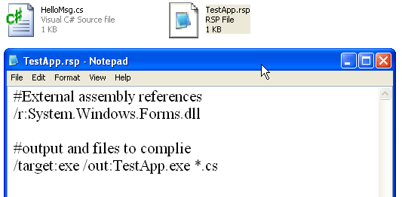
Building C# Applications Using csc.exe
Create a file with .rsp extension as below:

Slide 56
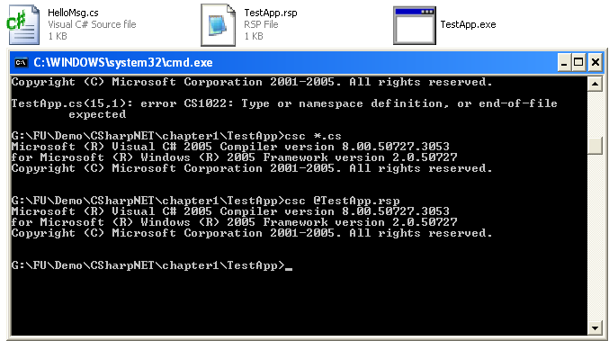
Building C# Applications Using csc.exe
Compiling a response file
csc @ResponseFile.rsp
Do not forget the @ sign before the response file name

Slide 57
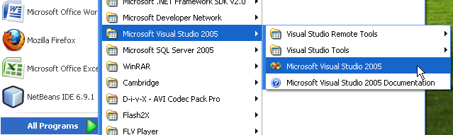
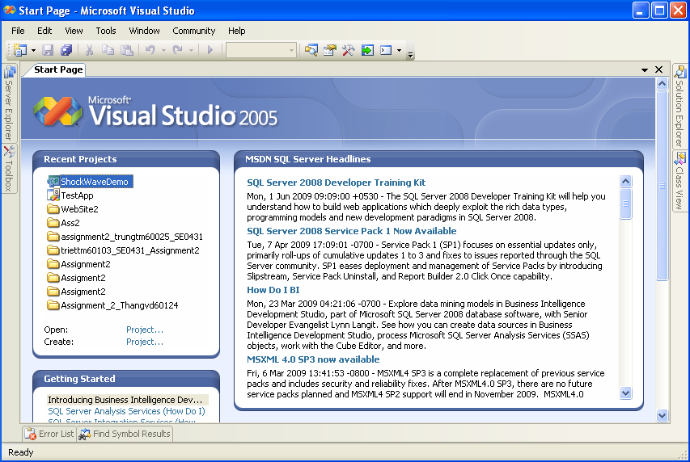
Building .NET Applications Using Visual Studio 2005

Slide 58
Building .NET Applications Using Visual Studio 2005
Advanced Features
Visual XML editors/designers
Support for mobile device development (such as Smart phones and Pocket PC devices)
Support for Microsoft Office development
The ability to track changes for a given source document and view revisions
Integrated support for code refactoring
An XML-based code expansion library
Visual class design tools and object test utilities
A code definition window (which replaces the functionality of the Windows Forms Class Viewer, wincv.exe, which shipped with .NET 1.1 and earlier)

Slide 59
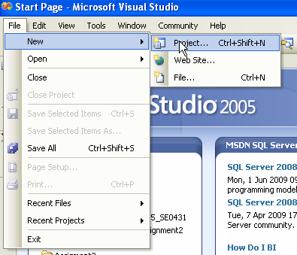
Create Project in VS 2005
From File menu, select New / Project

Slide 60
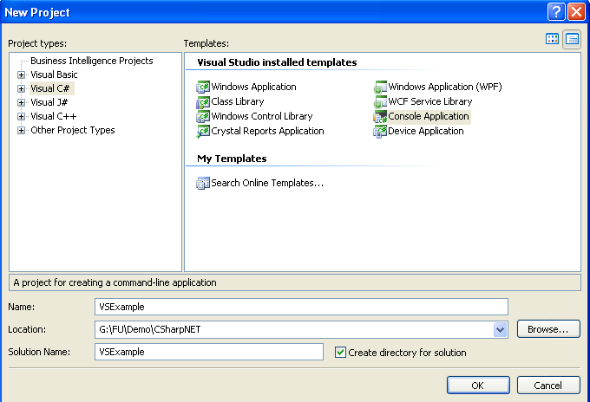
Create Project in VS 2005
1
2
Select language
Select project type
3
Enter project name
4
Enter location
5: OK

Slide 61
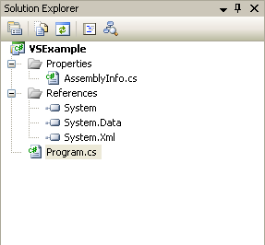
Create Project in VS 2005
Solution Explorer
Contains information about assembly itself
Contains references for the current project
Contains C# source code of the project

Slide 62
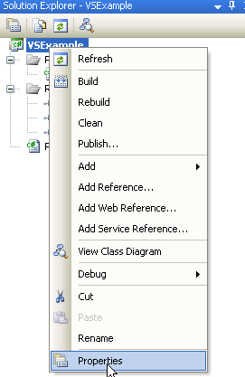
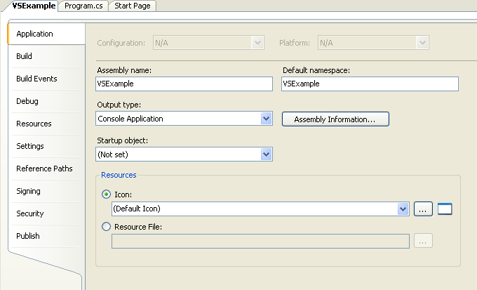
Create Project in VS 2005
Project Property Explorer
Config parameters for the project such as: assembly name, output type, icon and others

Slide 63
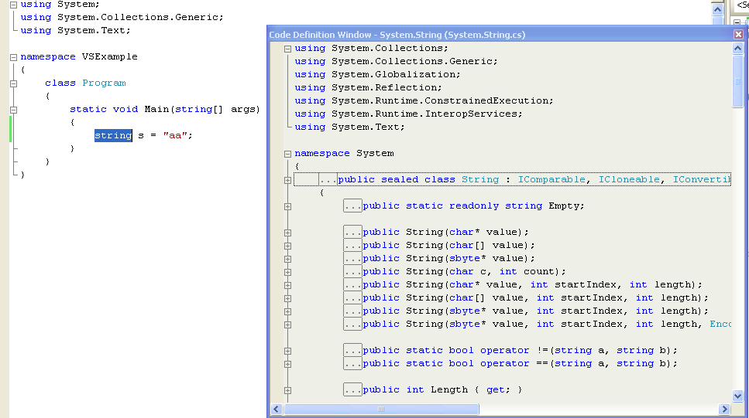
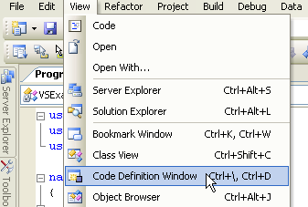
Create Project in VS 2005
Allow quickly accessing to other class without closing (or hiding) the current class window
Code Definition View
3
1
2

Slide 64
VS 2005: Coding Supports
Code Refactoring
A formal and mechanical process whereby you improve an existing code base.
Refactoring Technique | Description
Extract Method | Allows to define a new method based on a selection of code statements
Extract Interface | Defines a new interface type based on a set of existing type members
Rename | Allows to rename a code token (method name, field, local variable, and so on) throughout a project
Reorder Parameters | Provides a way to reorder member arguments
Remove Parameters | Removes a given argument from the current list of parameters

Slide 65
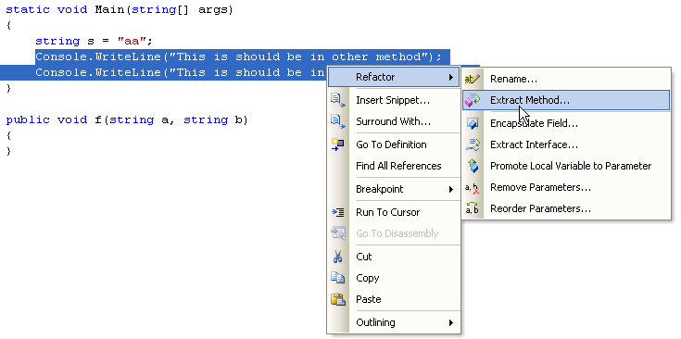
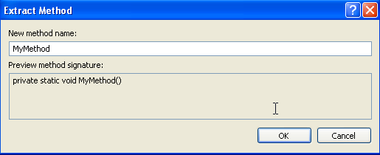
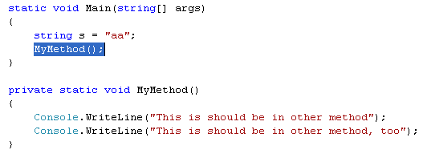
Code Refactoring: Extract method example
1
2
Enter method name
3

Slide 66
VS 2005: Coding Supports
Code Expansions and Surrounding
Snippets: These templates insert common code blocks at the location of the mouse cursor.
Surround With: These templates wrap a block of selected statements within a relevant scope.

Slide 67
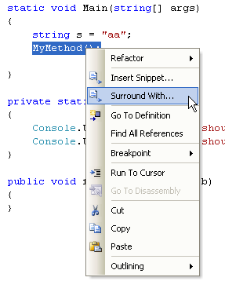
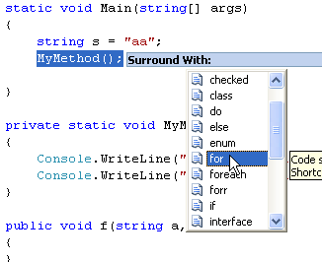
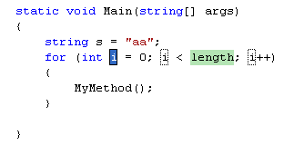
Code surrounding example
2
1
3

Slide 68
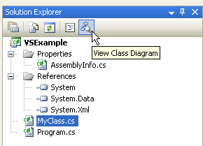
VS 2005: Coding Supports
Visual Class Designer

Slide 69
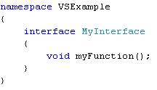


VS 2005: Coding Supports
Class Designer example

Slide 70
VS 2005: Coding Supports
Object Test Bench
Allows you to quickly create an instance of a class and invoke its members without the need to compile and run the entire application.

Slide 71





Object Test Bench example
2
1
4: click OK
3
5: result

Slide 72
Chapter 2: Q & A

Slide 73
Thank you

